Slide 1
Occupational Specialism
HTML, CSS, JAVASCRIPT (FRONT END)
PHP, SQL (BACK END)

Slide 2
Occupational Specialism Project
Year 2 Exam Dates | Task | Duration | Marks
Overall 09 Mar 2026 – 08 May 2026 |  | 67 hrs | 145
09 Mar – 20 Mar 2026 | Task 1: Analysing the problem and designing a solution. | 20hrs | 58
23 Mar – 24 Apr 2026 | Task 2: Developing the solution. | 30hrs | 48
27 Apr – 05 May 2026 | Task 3a: Gathering feedback to inform future development. | 15hrs | 24
06 May - 07 May 2026 | Task 3b: Evaluating feedback to inform further development | 2hrs | 15
Total Marks |  |  | 145

Slide 3
Occupational Specialism Project
Date | Task | Duration | Marks
2026 |  | 50.5 hrs | 144
Task 1 | Quality of Communication |  | 6
Task 1 | Activity A – Proposal | 9hrs | 24
Task 1 | Activity B - Visual Interface and Data Designs | 4.5hrs | 12
Task 1 | Activity C – Use of Generative AI | 4.5hrs | 12
Task 2 | Activity A - Developing the Solution | 12.5hrs | 30
Task 2 | Activity B - Documenting the Development Process | 7.5hrs | 18
Task 3 | Activity A – Gathering Feedback | 10hrs | 24
Task 3 | Activity B – Evaluation | 2.5hrs | 18
Total Marks |  |  | 144

Slide 4
Task1- Problem analysis and solution design
Carry out research into how a digital solution could meet the needs of the client and its customer/consumers
Produce a proposal and solution design
58 marks
20 hours

Slide 5
Task 1a and 1b breakdwon
1a.1 Decomposing the problem
1a.2 Appreciation of wider issues in the context
1a.3 Appreciation of the business context
1b.1 Effectiveness of the design interface
1b.2 Decomposition of problem
1b.3 Application of logical thinking and conventions
1b.4 The design of the data requirements
1b.5 Test strategy
1b.6Quality of communication

Slide 6
Task 1b -checklist
Documentation Set-up
Set up cover page, table of contents and page numbers
Interface design
Data requirements
Algorithms
Test strategy

Slide 7
Task 1b -checklist
Visual/interface designs
  Sitemap
  Well annotated wireframes
  Mock-up for each page (justify design layout, colour schemes, text sizes and fonts)
Data requirements
  Data dictionaries (variable name, data type, purpose, data validation rules, input mask, length)
  Entity-relationship diagrams (ERD)(tables, primary key, foreign keys)
  Data flow diagrams
  Acceptance testing

Slide 8
Task 1b -checklist
Algorithm designs
  Flowcharts (include those with calculations)
  Pseudocode
Test strategy (test table is provided)
  Unit testing
  Integration testing
  Black box testing
  System testing
  Acceptance testing
Cover different test types and specify the use of normal, erroneous, and extreme test data

Slide 9
Task 2 – Development of a project
Produce a functional prototype and document the process of the iterative development
48 marks
30 hours

Slide 10
Task 2 breakdown
Functionality (Q02.1) – consistent efficient functional code across multiple languages (HTML, CSS, JavaScript, PHP)
Code organisation (Q02.2) - logically organised into distinct functional blocks
User experience (Q02.3) – consistent effective use of input handling, user guidance, and outputs.
Legal and regulatory guidelines and Standards (Q02.4)
Suitability of test data. (Q02.5) – use a comprehensive range of test data, including normal, erroneous (invalid), and extreme (boundary) values.
Use of testing to inform the iterative development process (Q02.6)
Quality of iterative development process (Q02.7) - provide a clear and detailed narrative of the project’s evolution

Slide 11
Task 2 – Checklist
Set up cover page, table of contents and page numbers
Order functional requirements to start developing from home page
Develop navigation and footer and copy these across for consistency for each page.
Create and test links to each page – document on test table (save as Version 1)
Design and develop a register and login form – test form loading up
Validate form using javascript/php – test validation using null, valid, invalid and boundary data
Develop database table for the forms (create file to connect to db and create table)
Link form to database to insert data – test if table data goes into database (save as Version 2) screenshot of dbase table

Slide 12
Task 2 – Checklist
Design and develop any other forms e.g. booking
Develop API if required – test
Test calculations
Design and create cookies and sessions ( save as Version 3)
Cookie consent notice page
Privacy and data policy page
Intellectual property consideration – Complete asset log
Terms and conditions page
Develop remaining pages (include all content for each page) – test each page once it’s completed
Once all requirements have been completed – save final version

Slide 13
Task 2 – Checklist
Once all requirements have been completed – save final version
Documentation
Document every process in the order that you develop it. (Agile SDLC)
Add screenshot of code and explain the code, especially javascript and php. Explain how the code skills used e.g. functions, if statements, iterations and SQL queries meets the requirement
Test each component as you develop and complete it and document this on the test table and refer to it on the document and explain any issues and how they were resolved.

Slide 14
Task 3 – Handover and evaluation of prototype
Part A: To prepare materials for use in gathering feedback from technical and non-technical audiences
24 marks
15 hours
Part B: Evaluating the prototype and recommending improvements
15 marks
2 hours

Slide 15
Task 3a and 3b breakdown
3a.1 Effectiveness of materials to support the feedback process
3a.2 Use of appropriate feedback tools to support the gathering of effective feedback
3a.3 Effectiveness of communication
3b.1 Effectiveness of assets and content
3b.2 Evaluation of project outcomes

Slide 16
Task 3a - checklist
Produce materials to support the gathering of feedback and use them to gain feedback from technical and non-technical audiences
use appropriate tools, methods and techniques to prepare demonstrations of the prototype’s functionality, suitable for:
  a technical audience (e.g. programming professionals)
  a non-technical audience (e.g. the client, users)
produce a plan for how you intend to gather feedback
use the materials you produce to gather feedback
record the feedback received in a format(s) suitable for analysis.

Slide 17
Task 3a - checklist
Audience-specific feedback
Create two distinct questionnaires: one for a technical audience and one for a non-technical audience.
This dual-pronged approach enables a comprehensive evaluation of the project, encompassing both front-end usability and back-end integrity.
Examples of topics to cover – technical
Asking programmers to evaluate code maintainability
Adherence to PEP 8 standards,
Security vulnerabilities such as client-side business logic
Efficiency principles like the DRY principle (Don't Repeat Yourself)

Slide 18
Task 3a - checklist
Examples of topics to cover – non technical
Overall design
Intuitive Layout and Navigation
Navigation Menu and Logo
Interactive Features
Colour Palette
Ease of use e.g Booking Experience (depends on scenario)
Accessibility features
Data protection/ legal consideration (is data entered by user safe) cookies?

Slide 19
Task 3a - checklist
Types of questions
multiple-choice,
rating scales,
open-ended questions e.g “explain”

Slide 20
Task 3a - checklist
Examples of format of feedback
1. User Observations: Observing users attempting specific challenges, such as creating a booking to identify pain points provides
2. Paired Coding Reviews: Engaging with programmers for direct code reviews
3. Screen Recordings and Demonstrations: Providing users with a demonstration video before they interact with the site ensures they understand its full scope, leading to more informed feedback.
4. Questionnaires (Microsoft Forms) to gather data, and analyse this using the built-in data visualisation features, such as graphs and charts.

Slide 21
Task 3b - Checklist
Design and make cover page, table of contents and page numbers
Effectiveness of assets and content
Evaluation of project outcomes

Slide 22
Task 3b - Checklist
Design and make cover page, table of contents and page numbers
Effectiveness of assets and content
  why the chosen assets and content were selected, and why other content was rejected (relate to scenario appropriateness, technical compatibility)
  the validity and reliability of the sources of information used (AI generated, types of websites)
  any legal and ethical implications of the assets and content selected (copyright free images, AI generated)
Evaluation of project outcomes
  functional and non-functional requirements of the solution (evaluate how your prototype has met each of these and include evidence)
  key performance indicators (KPIs)
  user acceptance criteria for the proposed solution
how the prototype could be developed further
  Refer to any feedback from task 3a
  How can you improve user experience

Slide 23
OSP Scheduling
Week | Monday | Tuesday | Wednesday | Thrusday | Friday
Week 1 | Task 1 20 hours within a 3 week window
Week 2
Week 3
Week 4 | Task 2 30 hours within a 4 week window
Week 5
Week 6
Week 7
Week 8
Week 9 | Task 3a 15 hours within a 3 week window
Week 10
Week 11 | Task 3b: 2 hours

Slide 24
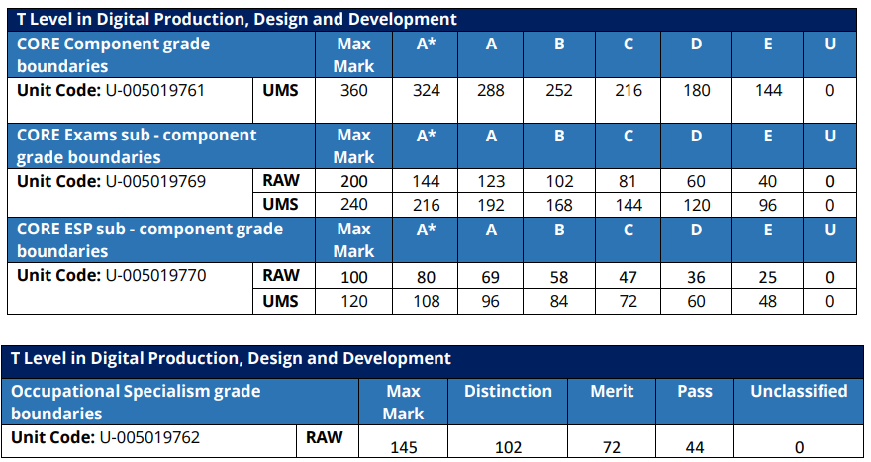
Grade boundaries 2025

